Slide 1
Server Independent Execution Manual
SFA

Slide 2
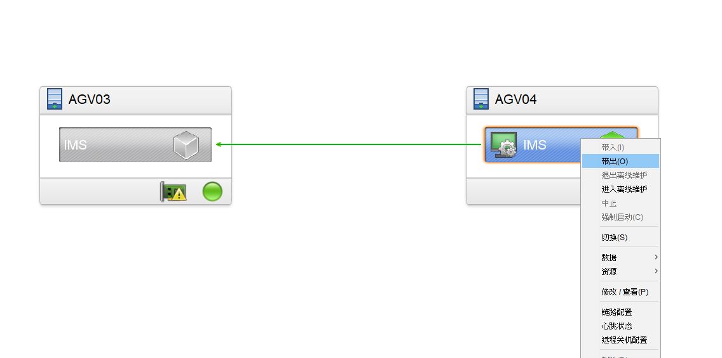
Server Independent Execution Manual
Rose Shutting down resources

Slide 3
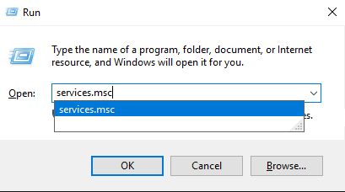
Server Independent Execution Manual
Windows key + R -> services.msc

Slide 4
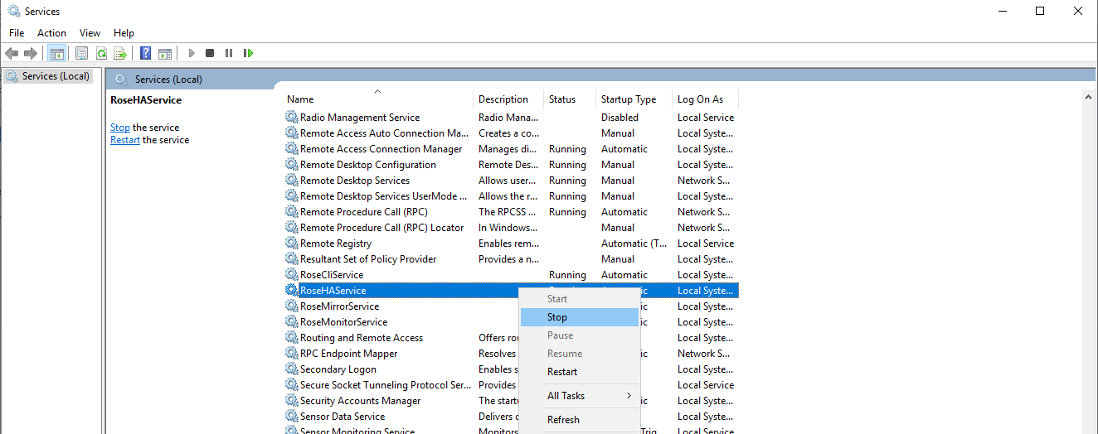
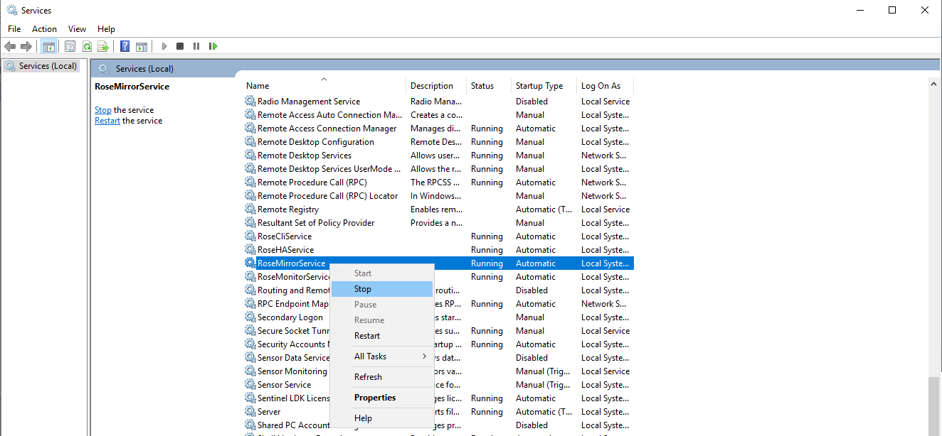
Server Independent Execution Manual
RoseHAService , RoseMirrorService -> Stop
(AGV03,AGV04 Same for both servers)

Slide 5
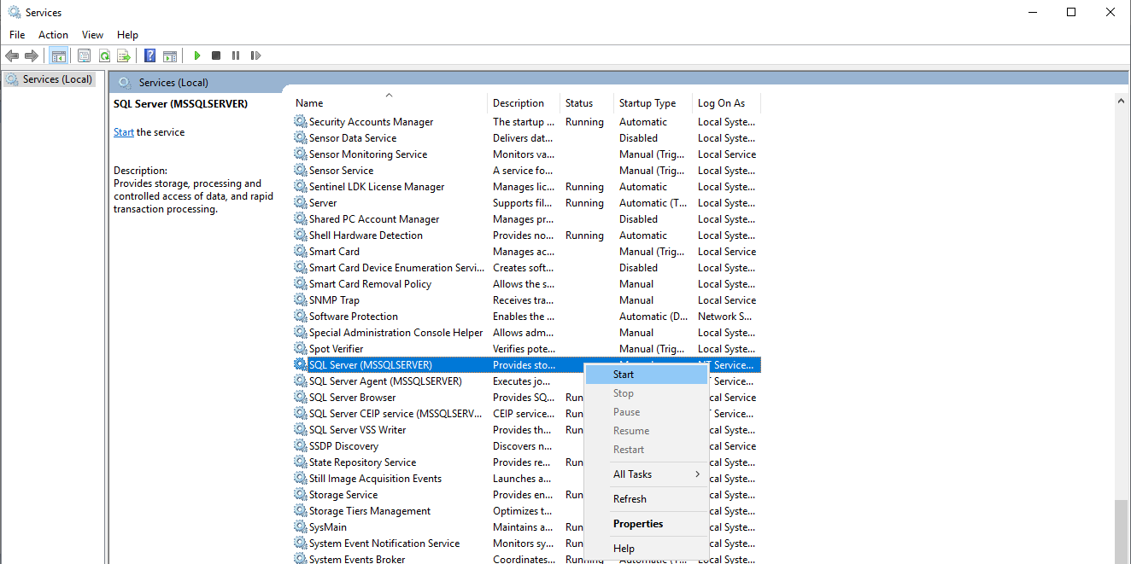
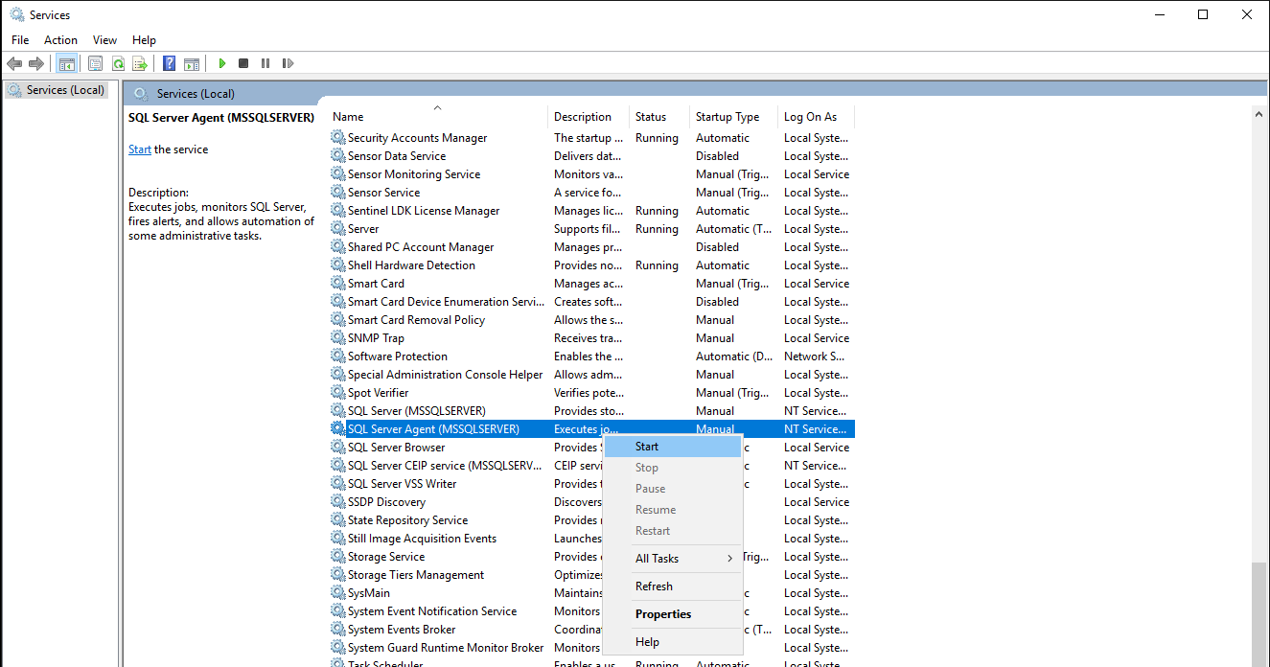
Server Independent Execution Manual
SQL Server(MSSQLSERVER),SQL Server Agent(MSSQLSERVER)
->START (Servers to operate manually)

Slide 6
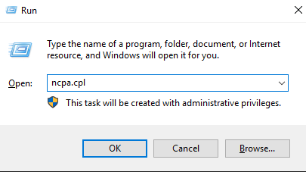
Server Independent Execution Manual
Windows key + R -> ncpa.cpl

Slide 7
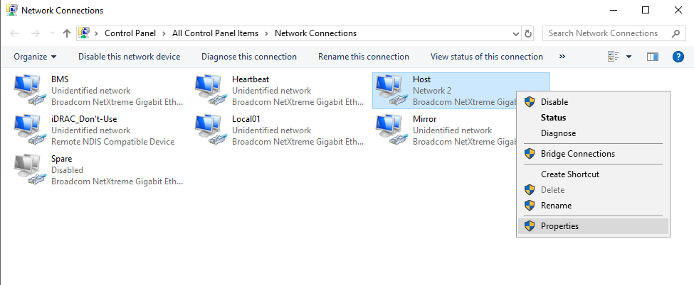
Server Independent Execution Manual
Host -> Properties

Slide 8
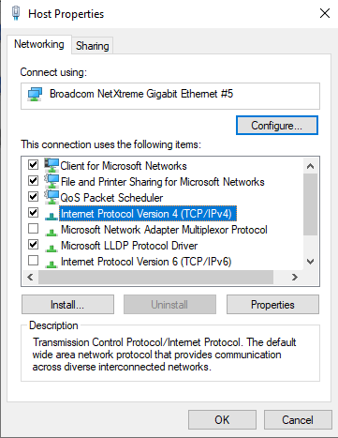
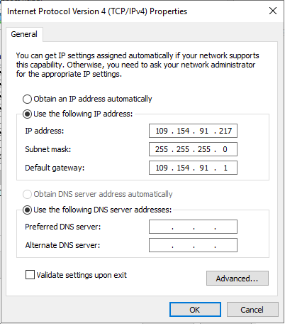
Server Independent Execution Manual
③
①
②
⑤
④
Internet Protocol Version 4(TCP/IPv4) -> Properties -> IP Replacement -> OK -> OK

Slide 9
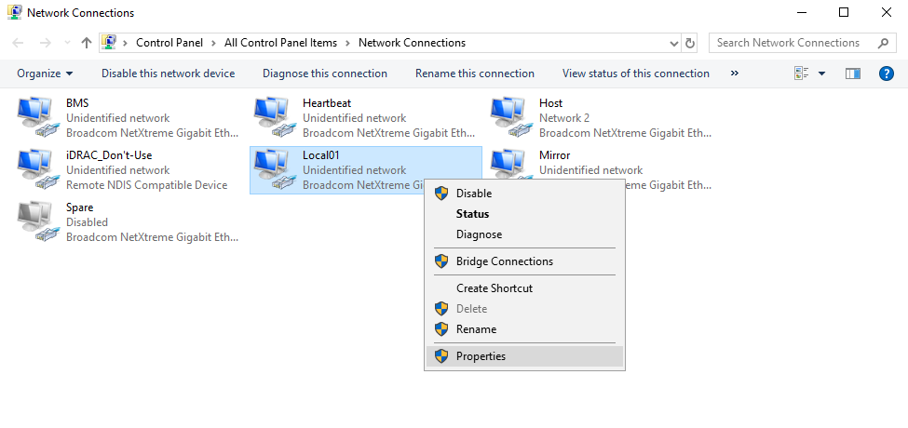
Server Independent Execution Manual
Local01 -> Properties

Slide 10
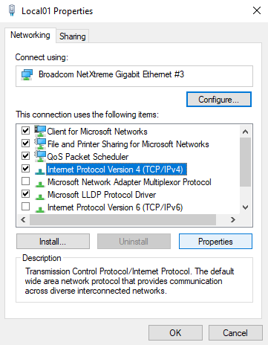
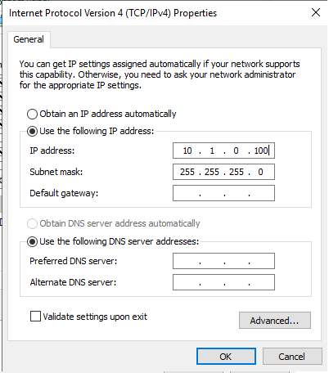
Server Independent Execution Manual
③
①
②
⑤
④
Internet Protocol Version 4(TCP/IPv4) -> Properties -> IP Replacement -> OK -> OK

Slide 11

Server Independent Execution Manual
Run Program files in that path in order
Core -> D:\Program\Core\Core.exe
MCS_IF -> D:\Program\MCS_IF\MCS_IF.exe
PlcDriver -> D:\Program\PLCDRIVER\PlcDriver.exe

